Slide 1
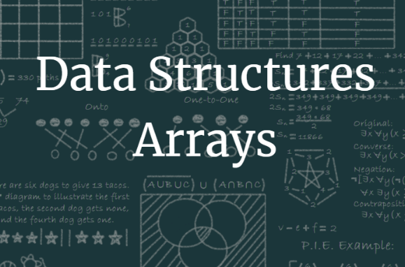
Unit 10.1 - Data Types & Arrays
Prepared by: Koh Kian Hua

Slide 2
Objectives
After completing this unit, students should be able to:
Select and use appropriate data types for a problem solution including integer, real, char, string, Boolean, date.
Show understanding of the purpose of a record structure to hold a set of data of different data types under one identifier.
Write pseudocode to define a record structure.
Write pseudocode to read data from a record structure and save data to a record structure.
Use the technical terms associated with arrays including index, upper and lower bound.
Select a suitable data structure (1D or 2D array) to use for a given task.
Write pseudocode for 1D and 2D arrays and process array data
Sort using a bubble sort and search using a linear search

Slide 3
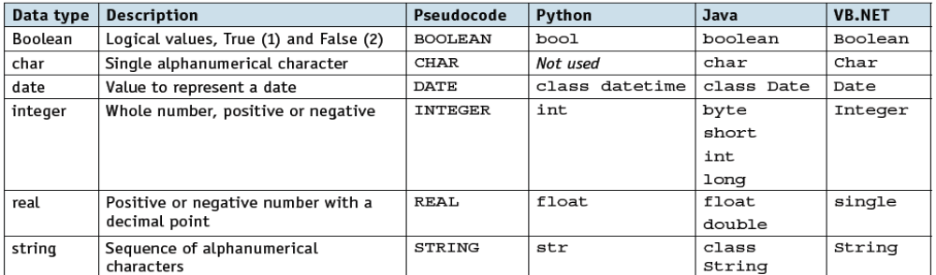
Data Types and Arrays
Data Types
Data types allow programming languages to provide different classifications for items of data, so they can be used for different purposes.
  Integers are discrete whole numbers used for counting and indexing.
  Real numbers can be used to provide accurate measurements.
Programming languages have a number of built in data types shown in the gtable below.

Slide 4
Data Types and Arrays
Data Types
Before data can be used, the type needs to be decided.
  This is done by declaring the data type for each item to be used.
  Each data item is identified by a unique name, called an identifier.
In pseudocode a declaration statement takes this form:
DECLARE <identifier> : <data type>
For example:
DECLARE myBirthday : DATE

Slide 5
Data Types and Arrays
Records
Records are composite data types formed by the inclusion of several related items that may be of different data types.
A record will contain a fixed number of items.
For example, a record for a book could include title, author, publisher, number of pages, and whether it is fiction or non-fiction.
A record data type is one example of a composite user-defined data type.
  A composite data type references other existing data types when it is defined.
  A composite data type must be defined before it can be used.
  Any data type not provided by a programming language must be defined before it can be used.

Slide 6
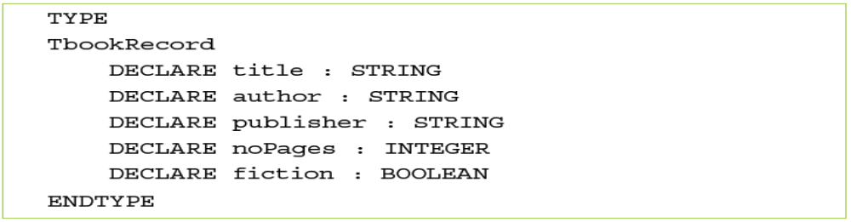
Data Types and Arrays
Records
For example, the book record data type could be defined like this:
The data type, TbookRecord, is now available for use and an identifier may now be declared in the usual way:
Items from the record are now available for use and are identified by:
<identifier>.<item identifier>
For example:

Slide 7
Data Types and Arrays
Arrays
An array is a data structure containing several elements of the same data type; these elements can be accessed using the same identifier name.
The position of each element in an array is identified using the array’s index.
  The index of the first element in an array is the lower bound and the index of the last element is the upper bound.
  The lower bound of an array is usually set as zero or one.
Arrays can be one-dimensional or multi-dimensional.

Slide 8
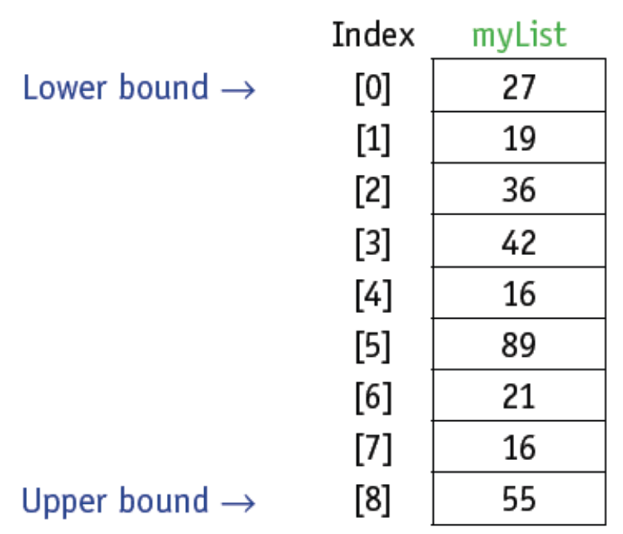
Data Types and Arrays
1D Array
A 1D array can be referred to as a list.
An example of a list with nine elements and a lower bound of zero.

Slide 9
Data Types and Arrays
1D Array
To declare a 1D array is declare a 1D array in pseudocode, the lower bound (LB), upper bound (UB) and data type are included:
For example:
The declared array can then be used, as follows:
Note: This will assign a value of 16 to element eight of the array

Slide 10
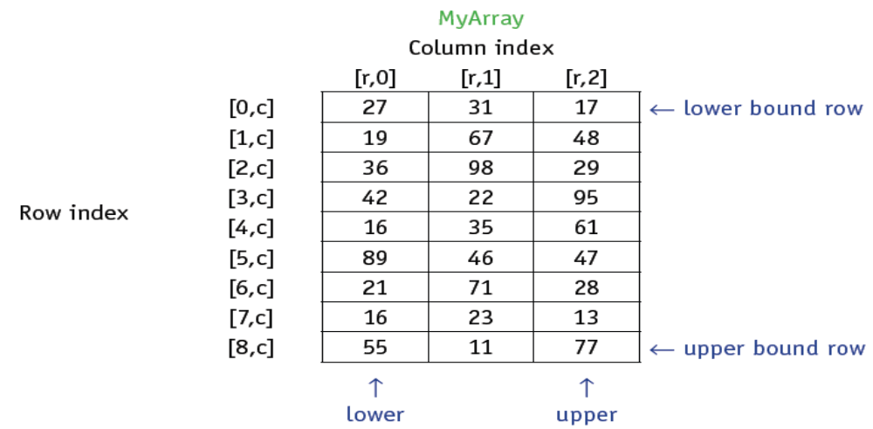
Data Types and Arrays
2D Array
A 2D array can be referred to as a table, with rows and columns.
An example of a table with nine rows and three columns (27 elements) and lower bounds of zero.

Slide 11
Data Types and Arrays
2D Array
To declare a 2D array in pseudocode, the lower bound for rows (LBR) and the upper bound for rows (UBR), the lower bound for columns (LBC) and the upper bound for columns (UBC), and data type are included:
For example:
The declared array can then be used, as follows:
Note: This will assign the value of 16 to row 8 and column 0 of the 2D array

Slide 12
Data Types and Arrays
Use of Arrays (1D & 2D)
Arrays are used to store multiple data items in a uniformly accessible manner.
All the data items use the same identifier and each data item can be accessed separately by the use of an index.
In this way, lists of items in the array can be stored, searched and put into an order.
For example, a list of names can be ordered alphabetically; and a list of temperatures can be searched to find a particular value.

Slide 13
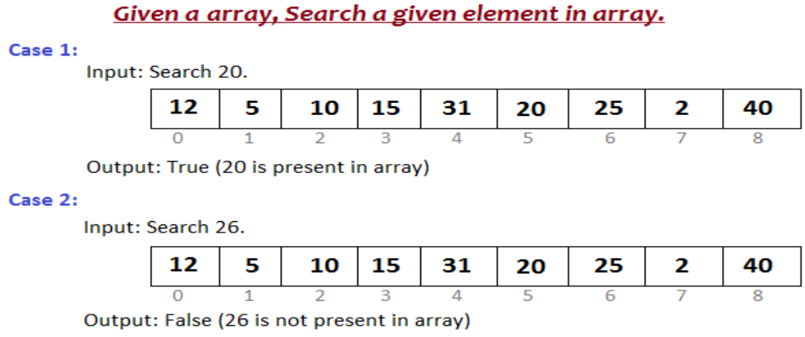
Data Types and Arrays
Linear Search In a 1D Array
To find an item stored in an array, the array needs to be searched.
One method of searching is a linear search.
Each element of the array is checked in order, from the lower bound to the upper bound, until the item is found or the upper bound is reached.

Slide 14
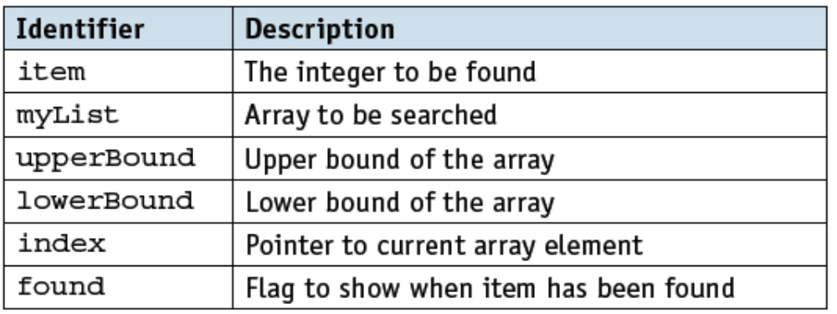
Data Types and Arrays
Pseudo Code for Linear Search in Array List
DECLARE upperBound : INTEGER
DECLARE lowerBound : INTEGER
DECLARE index : INTEGER
DECLARE item : INTEGER
DECLARE found : BOOLEAN
upperBound ← 8
lowerBound ← 0
OUTPUT "Please enter item to be found"
INPUT item
found ← FALSE
index ← lowerBound
REPEAT
IF item = myList[index]
THEN
found ← TRUE
ENDIF
index ← index + 1
UNTIL (found = TRUE) OR (index > upperBound)
IF found
THEN
OUTPUT "Item found"
ELSE
OUTPUT "Item not found"
ENDIF
Identifiable table
Note
The algorithm uses the variables upperBound and lowerBound so that the algorithm is easier to adapt for different lengths of list.
The REPEAT … UNTIL loop makes use of two conditions, so that the algorithm is more efficient, terminating as soon as the item is found in the list.

Slide 15
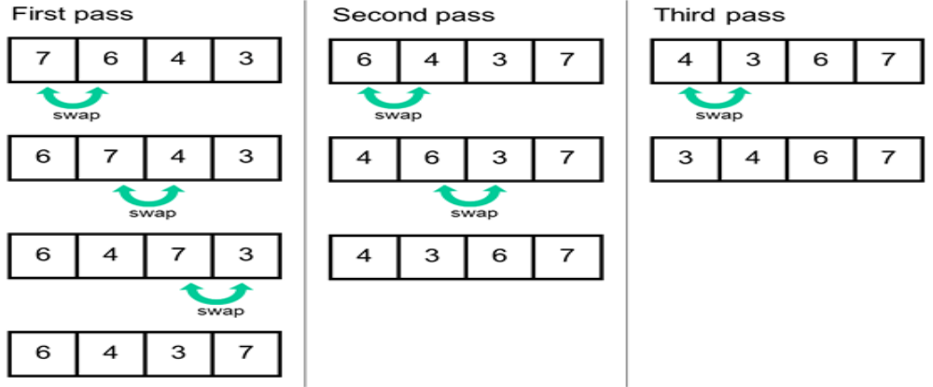
Data Types and Arrays
Using Bubble Sort on Array List
Bubble sort is a basic algorithm for arranging a string of numbers or other elements in the correct order.
The method works by examining each set of adjacent elements in the string, from left to right, switching their positions if they are out of order
Bubble Sort Algorithm

Slide 16
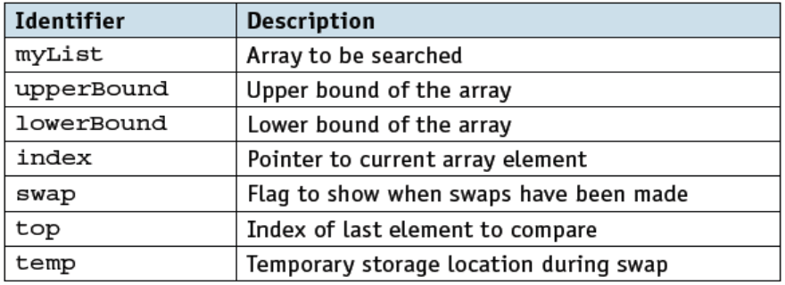
Data Types and Arrays
Pseudo Code of Bubble Sort on Array List
DECLARE myList : ARRAY[0:8] OF INTEGER
DECLARE upperBound : INTEGER
DECLARE lowerBound : INTEGER
DECLARE index : INTEGER
DECLARE swap : BOOLEAN
DECLARE temp : INTEGER
DECLARE top : INTEGER
upperBound ← 8
lowerBound ← 0
top ← upperBound
REPEAT
FOR index = lowerBound TO top - 1
Swap ← FALSE
IF myList[index] > myList[index + 1]
THEN
temp ← myList[index]
myList[index] ← myList[index + 1]
myList[index + 1] ← temp
swap ← TRUE
ENDIF
NEXT
top ← top -1
UNTIL (NOT swap) OR (top = 0)
Identifiable Table
How Bubble Sort works:
Each element of the array is compared with the next element and swapped if the elements are in the wrong order, starting from the lower bound and finishing with the element next to the upper bound.
The element at the upper bound is now in the correct position.
This comparison is repeated with one less element in the list, until there is only one element left or no swaps are made.

Slide 17
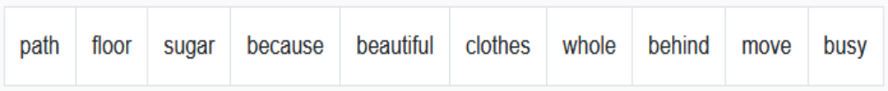
Class Activity
Write Pseudo Code to store a list of 10 words (shown in the picture) into an array.Then, use a for loop to print out all the words that are stored in the array.

Slide 18

Unit 10.2 - File Input & Output
Prepared by: Koh Kian Hua

Slide 19
Objectives
After completing this unit, students should be able to:
Show understanding of why files are needed
Write pseudocode to handle text files that consist of one or more lines

Slide 20
File I/O
File I/O (Input & Output)
Computer programs store data that will be required again in a file.
Every file is identified by its filename.
Text files contain a sequence of characters.
Text files can include an end of line character that enables the file to be read from and written to as lines of characters.

Slide 21
File I/O
File I/O (Input & Output)
Pseudo Code to Open a File
OPEN <file identifier> FOR <file mode>
Files can be opened in one of the following modes:
Mode | Description
READ | reads data from the file
WRITE | writes data to the file, any existing data stored in the file will be overwritten
APPEND | adds data to the end of the file

Slide 22
File I/O
File I/O (Input & Output)
Pseudo Code to READ a file a line at a time
READFILE <file identifier>, <variable>
Pseudo Code to WRITE OR APPEND a file a line at a time
WRITEFILE <file identifier>, <variable>
Note: In both cases, variable should be a string type.
Pseudo Code to TEST for EOF (END OF FILE)
EOF(<file identifier>)
Pseudo CLOSE a file when it's no longer needed
CLOSEFILE <file identifier>

Slide 23
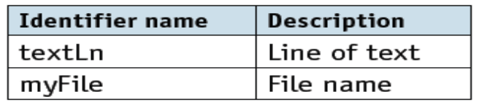
File I/O
Writing and Reading a File (Pseudo Code)
DECLARE textLn : STRING
DECLARE myFile : STRING
myFile ← "myText.txt"
OPEN myFile FOR WRITE
REPEAT
OUTPUT "Please enter a line of text"
INPUT textLn
IF textLn <> ""
THEN
WRITEFILE, textLn
ELSE
CLOSEFILE(myFile)
ENDIF
UNTIL textLn = ""
OUTPUT "The file contains these lines of text:"
OPEN myFile FOR READ
REPEAT
READFILE, textLn
OUTPUT textLn
UNTIL EOF(myFile)
CLOSEFILE(myFile)
Identifier Table

Slide 24
Class Activity
When you open a file, you will specify the access mode in which you will work. There are 3 types of file-access modes. Briefly explain the 3 types of file-access modes

